Slide 1
SWE 4101
Lec - 1
SW Engineering

Slide 2
Class Schedule
Day | Time (Room#)
Wednesday | 9:15 - 10:30 (205)
Friday | 8:00 - 9:15(301)

Slide 3

Important For you

Slide 4
Lecture Plan
Weeks | Topics
1 | Introduction to SW Engineering, SW Development Lifecycle, SW Processes Model
2 | SW Requirement Analysis , UI Specification and UI Design
3 | SW Requirement Analysis
4 | SW Design basics, modeling Using UML
5 | Clean Coding, Debugging and Unit testing
6 | SW Testing
7 | SW release and Maintenance

Slide 5
Looking for SW Engineer
Software Engineer Experience: At least 1 year
Education
Bachelor of Computer Science & Engineering.
Job Description:
We are seeking an experienced, self-motivated Senior Software Engineer with 1/2 years of experience developing applications. As a Senior Software Engineer, you will collaboratively identify, design, develop and deploy technology and process solutions to implement highly scalable business applications in Linux and Windows environments. This role requires technical expertise, Banking and NBFI domain proficiency and .NET platform hands-on experience.
Responsibilities:
Collaborates with the development team and initiates process improvements for new and existing systems.
Participates in the solution design process: requirements gathering, and backlog refinement, shapes, and guides systems approach, helps with project initiation, contributes to functional design, technical design and development.
Develop software solutions to business problems. Leverages established design patterns and coding standards. Builds solutions that are secure, durable, scalable, flexible, and accessible and proactively mitigate against production support issues.
Automates test coverage per platform capabilities and requirements. Establishes and maintains continuous build and integration testing on applicable platforms and assists with manual system and integration testing efforts.
Operates in both waterfall and Agile Software Development Lifecycle (SDLC) processes and methodologies.

Slide 6
Looking for SW Engineer
Software Engineer Experience: At least 1 year
Core Competencies:
Customer Focus - Delivers legendary service that meets and exceeds all customers' expectations.
Ethics and Integrity - Adheres to Leads values, beliefs, and principles during good and bad times.
Composure - Remains calm, maintains perspective and responds professionally when faced with tough situations.
Personal Learning - Takes personal responsibility for the continuous learning of new knowledge, skills and experiences.
Dealing with Ambiguity - Able to successfully function during times of uncertainty and changing priorities.
Decision-Making - Makes timely and quality decisions based on a mixture of analysis, wisdom, experience, and judgment.
Interpersonal Skill - Builds effective relationships with all people; up, down, and sideways, inside and outside of Leads.
Results Oriented - Gets results and achieves goals.

Slide 7
Looking for SW Engineer
Software Engineer Experience: At least 1 year
Additional Requirements
Requires 1/2 years of hands-on experience in SQL.
Requires 1/2 years’ experience in the IT industry.
Strong experience in C#, data structures and collections.
Experience with using ASP.NET 4 Web Form, IIS and Visual Studio.
Experience in working with Linux and Windows environments.
Extensive understanding of SDLC and scrum methodologies.
Experience in .Net Core would be plus.
Experience in database development using PL/SQL would be plus.
Experience in configuring, and deploying applications in IIS would be plus.
Experience in using configuration management tools like Team Foundation Version Control (TFVC), Git would be plus.
Strong interpersonal skills
Requires excellent oral, written, and presentation skills
Strong analytical and problem-solving skills
Ability to quickly learn new application systems and technologies
Experience in the interpretation of functional requirements
Conduct code reviews with the team to improve compliance with established best practices and coding standards
Work with team members to ensure application designs are in line with best practices and are scalable, reliable, and that all designs optimize performance and usability.

Slide 8

What is SW Engineering
Software engineering is defined as a discipline whose aim is the production of quality software, delivered on time and within the budget and that satisfies its requirement.
IEEE, in its standard 610.12-1990, defines software engineering as the application of a systematic, disciplined, which is a computable approach for the development, operation, and maintenance of software.

Slide 9


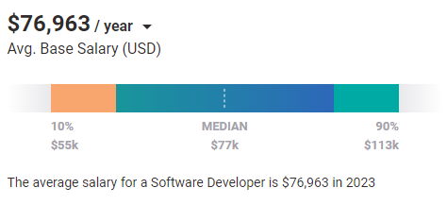
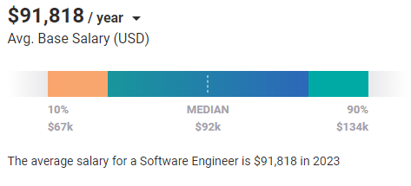
SW Developer(Programmer) vs SW Engineer
Based on 16,538 salary profiles (last updated Jul 26’2023)
Based on 48,807 salary profiles (last updated Jul 26’2023)

Slide 10
Key Difference
Software Engineer applies the principles of software engineering for designing, development, maintenance, testing, and evaluation of computer software whereas Software Developer builds software which runs across various types of computer.
Software Engineer works with other components of the hardware system whereas Software Developers write a complete program.
Software Engineer creates the tools to develop software while Software Developers use readymade tools to build apps.
Software Engineer tends to solve issues on a much larger scale whereas Software Developers tend to do everything that engineers do but on a limited scale.

Slide 11

What is Industry demand?
SW Developer or SW Engineer

Slide 12
Challenges of Software Engineering
In safety-critical areas such as space, aviation, nuclear power plants, etc. the cost of software failure can be massive because lives are at risk.
Increased market demands for fast turnaround time.
Dealing with the increased complexity of software and need for new applications.
"The complexity of software is an essential property, not an accidental one"

Slide 13
Software engineering ethics
ACM/IEEE-CS Joint Task Force on Software Engineering Ethics and Professional Practices.
The Ethical Principles are:
1. PUBLIC - Software engineers shall act consistently with the public interest.
2. CLIENT AND EMPLOYER - Software engineers shall act in a manner that is in the best interests of their client and employer consistent with the public interest.
3. PRODUCT - Software engineers shall ensure that their products and related modifications meet the highest professional standards possible.
4. JUDGMENT - Software engineers shall maintain integrity and independence in their professional judgment.
5. MANAGEMENT - Software engineering managers and leaders shall subscribe to and promote an ethical approach to the management of software development and maintenance.
6. PROFESSION - Software engineers shall advance the integrity and reputation of the profession consistent with the public interest.
7. COLLEAGUES - Software engineers shall be fair to and supportive of their colleagues.
8. SELF - Software engineers shall participate in lifelong learning regarding the practice of their profession and shall promote an ethical approach to the practice of the profession.
https://ethics.acm.org/code-of-ethics/software-engineering-code/

Slide 14
Software engineering ethics
Principle | Common Violation
Public | Privacy breaches, unsafe software
Client & Employer | Data leakage, dishonesty
Product | Poor quality, untested software
Judgment | Yielding to pressure
Management | Unethical deadlines, hiding defects
Profession | False expertise
Colleagues | Unfair credit, blame
Self | No skill updates, ignoring ethics

Slide 15
What is Software(SW)
is a set of instructions (computer program) and its associated documentations that tells a computer what to do or how to perform a task.

Slide 16
attributes of good software
Product characteristic | Description
Maintainability | Software should be written in such a way so that it can evolve to meet the changing needs of customers. This is a critical attribute because software change is an inevitable requirement of a changing business environment.
Dependability and security | Software dependability includes a range of characteristics including reliability, security and safety. Dependable software should not cause physical or economic damage in the event of system failure. Malicious users should not be able to access or damage the system.
Efficiency | Software should not make wasteful use of system resources such as memory and processor cycles. Efficiency therefore includes responsiveness, processing time, memory utilisation, etc.
Acceptability | Software must be acceptable to the type of users for which it is designed. This means that it must be understandable, usable and compatible with other systems that they use.

Slide 17
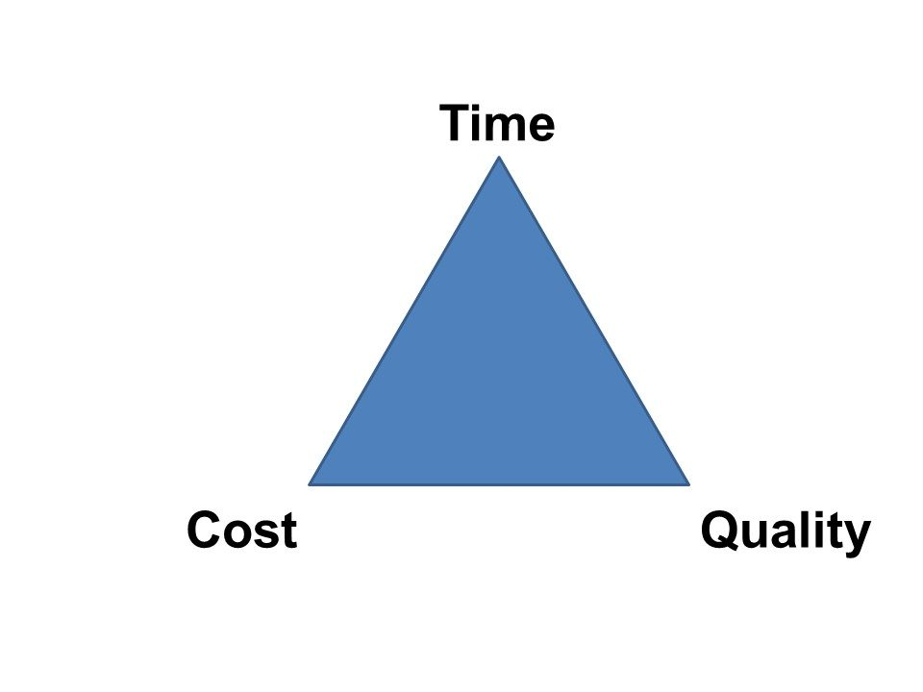
Industry Standard SW
quality, cost, and schedule are the main forces that drive an industry standard software project.
should be produced at reasonable cost, in a reasonable time, and should be of good quality.

Slide 18
SW Development Life Cycle (SDLC)

Slide 19
SW Development Life Cycle (SDLC)
is a systematic process for building software that ensures the quality and correctness of the software built.
SDLC aims to produce high-quality software that meets customer expectations.

Slide 20
Why SDLC
It offers a basis for project planning, scheduling, and estimating
Provides a framework for a standard set of activities and deliverables
It is a mechanism for project tracking and control
Increases visibility of project planning to all involved stakeholders of the development process
Increased and enhance development speed
Improved client relations
Helps you to decrease project risk and project management plan overhead

Slide 21
SDLC Phases
Requirement Analysis
Feasibility
Design
Coding
Testing
Deploy
Maintenance
Phase 1: Requirement gathering and analysis
Phase 2: Feasibility
Phase 3: Design
Phase 4: Coding
Phase 5: Testing
Phase 6: Installation/Deployment
Phase 7: Maintenance

Slide 22
Requirement gathering and analysis
is one of the most critical phases of SDLC.
the basis of the whole software development process.
All the business requirements are gathered from the client in this phase.
Requirements are analyzed to prepare SW specification, A well defined document known as Software Requirement Specification (SRS).
is divided into two phases where requirement gathering is related to identify client’s projects technical requisites and the Analysis is to evaluate whether the accumulated information and facts are valuable enough to proceed with the project plan.

Slide 23
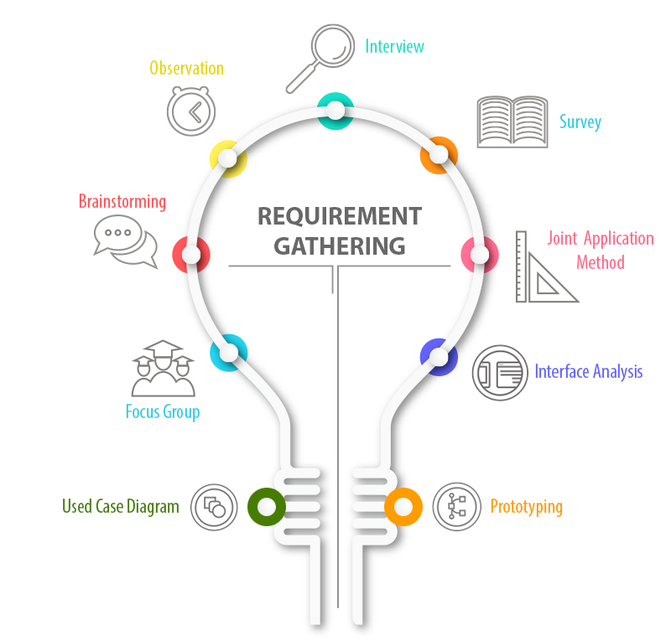
Requirement gathering and analysis
the business analyst talks to the user and clients who are unable to give out detailed information as they are not aware of the system development and related functionalities.
What are the tools and techniques of requirement gathering?
the responsible person observes the team in working environment and gets ideas about the software and subsequently document the observation.
Questionnaire delivered to the user as well as the stakeholder for answers.
subject matter experts are the responsible people to conduct brainstorming sessions. They discuss and find out solutions to complex issues.
all the stakeholders like developers, end users, business analysts and software engineers come together and attend workshops for working on a system in greater detail.
the idea is to collect information from representatives of clients and users to understand the software idea clearly.
Interface analysis is a specialized technique in which specific requirements related to application development are determined and their interaction with other software components is measured.
Use case diagram is a technique that shows how people interact with software. It shows what a system does.
building a model of software which helps in uncovering and capturing software requirements from client.

Slide 24
Requirement gathering and analysis
Challenges in Requirements Gathering
Lack of Clarity in Defining Criteria for Success
Clients Change their Minds Often
Lack of or Over Communication by Clients
Clients get stuck over certain Techniques/Solutions
Stakeholders can have Conflicting Priorities

Slide 25
Feasibility
Five types of feasibility check we need to perform
Operational
Can we create operations which is expected by the client?
03
Economic
01
Can we complete the project within the budget or not?
Technical
Need to check whether the current computer system can support the software
04
Legal
02
Can we handle this project as cyber law and other regulatory framework/compliances.
Schedule
Decide that the project can be completed within the given schedule or not.
05

Slide 26
Design
Design documents are prepared as per the SRS.
Helps to define overall system architecture.
There are two kinds of design documents developed in this phase:
High-Level Design (HLD)
Brief description and name of each module
An outline about the functionality of every module
Interface relationship and dependencies between modules
Database tables identified along with their key elements
Complete architecture diagrams along with technology details
Low-Level Design(LLD) / Detail Level Design (DLD)
Functional logic of the modules
Database tables, which include type and size
Complete detail of the interface
Addresses all types of dependency issues
Listing of error messages
Complete input and outputs for every module

Slide 27
Coding
developers start build the entire system by writing code using the chosen programming language.
tasks are divided into units or modules and assigned to the various developers.
is the longest phase of the Software Development Life Cycle process
developer needs to follow certain predefined coding guidelines
also need to use programming tools like compiler, interpreters, debugger to generate and implement the code.

Slide 28
Coding
Things which we need to take care in coding phase:
Version control
Before actual coding, you must spend sometime to select dev tool which will be suitable for debugging, coding, modification.
before actual writing code, some standard should be defined, as multiple developers going to use the same file for coding
during development, developer should write appropriate comments so that others will come to know the logic behind the code
there should be a regular review meeting need to conduct in this stage to identify the prospective defects in an early stage.

Slide 29
Testing
Focus on investigation and discovery
defines how the SW will be tested and who will perform
find whether the developed code work according to the customer requirement.
QA and testing team may find some bugs/defects which they communicate to developers.
development team fixes the bug and send back to tesing team for a re-test.
process continues until the software is bug-free, stable, and working according to the business needs of that system.

Slide 30
Installation/Deployment
Deployment is the process of promoting a fully-tested and approved application
QA manager finalized the final bug-free release items.
Deployment guide is provided to the operation team for hassle free deployment
Deployment could require different promotion processes
  For web applications, it would require promoting the application to a server, testing, redirecting DNS
  For standalone applications, it would require producing media or downloadable packages
  For software as a service, there are licensing issues that need to be determined
Ensure data migration to the live server has occurred completely

Slide 31
Maintenance
Major Activities after SW deployment/while SW in use by the end users
Bug fixing
bugs are reported because of some scenarios which are not tested at all
maintenance
Upgrade
Upgrading the application to the newer versions of the Software
Enhancement
Adding some new features into the existing software
The main focus of this phase is to ensure that needs continue to be met and that the system continues to perform as per the specification mentioned in the first phase.

Slide 32
Why do we need a SW upgrade?

Slide 33
Inherent Problems with Software Development
Requirements are complex
  The client does not know the functional requirements in advance
Requirements may be changing
  Technology enablers introduce new possibilities to deal with nonfunctional requirements
Frequent changes are difficult to manage
  Identifying milestones and cost estimation is difficult
There is more than one software system
  New system must be backward compatible with existing system (“legacy system”)
  Phased development: Need to distinguish between the system under development and already released systems
All these lead us to software life cycle modeling

Slide 34
SW Development Life Cycle (SDLC) Models
Popular Software developing life cycles (SDLC) models:
Waterfall Model
V-Shaped Model
Iterative Incremental Model
Spiral Model
Prototyping Model
Agile development

Slide 35
Waterfall Model
The first formal description of the waterfall model is often cited as a 1970 article by Winston W.Royce.
Royce presented this model as an example of a flawed, non-working model.
It has been widely used for software projects ever since.
Royce, Winston (1970), "Managing the Development of Large Software Systems"

Slide 36
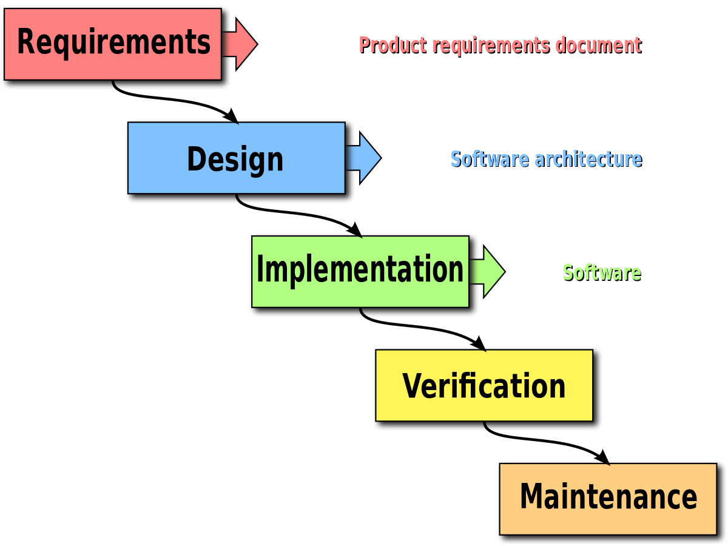
Waterfall Model
It is also called as linear sequential model.
In this model whole application is developed in a sequential approach.
In this model each phase must be completed fully before the next phase begin.
does not define the process to go back to the previous phase to handle changes in requirement.
Provides structure to inexperienced staff.

Slide 37
When to use Waterfall Model
List of things to consider when using the waterfall:
The requirements are clear and frozen.
Technology is understood and used by the team in different projects.
The project cannot be delivered in an iterative manner.
Documentation is essential.
Professional Project management skills.
The project cost is defined.

Slide 38
Waterfall Model - Advantages
It is very easy to explain to the business users and explain the output of each phase.
Structured approach.
Stages and activities are well defined.
It is easier for project managers to plan, schedule the project, utilize the resources, and define the milestones easily.
Validation and verification at each phase ensure early detection of errors or misunderstanding at the same phase.
Each phase has specific deliverables.

Slide 39
Waterfall Model - Disadvantages
It takes the full lifecycle to deliver a workable solution to the customer.
It is very difficult to go back to any phase after it finished.
It assumes that the requirements of a system can be frozen without any changes or enhancements.
A little flexibility and adjusting scope is difficult and expensive.
It requires more time for the detailed plan upfront of the project, as the requirements are clear and frozen and it should be visible to have the detailed plan delivered to the customer.
It delays the testing phase which can discover a lot of issues in requirements, design, and implementation as well.

Slide 40
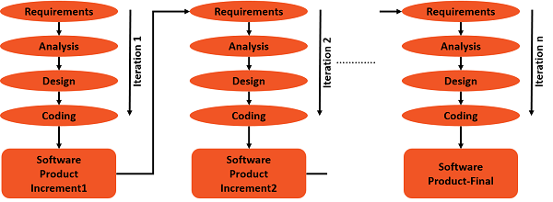
Iterative Incremental Model
developed to overcome the weaknesses of the waterfall model.
starts with an initial planning and ends with deployment with the cyclic interactions in between.
The basic idea behind this method is to develop a system through repeated cycles (iterative) and in smaller portions at a time (incremental).
allowing software developers to take advantage of what was learned during the development of earlier parts or versions of the system.
It can consist of mini waterfalls model

Slide 41
When to use Iterative & Incremental Method
List of things to consider :
Most of the requirements are known up-front but are expected to evolve over time.
The requirements are prioritized.
There is a need to get the basic functionality delivered fast.
A project has lengthy development schedules.
A project has new technology.
The domain is new to the team.

Slide 42
Iterative Incremental Model - Advantages
You can develop prioritized requirements first.
Initial product delivery is faster.
Customers gets important functionality early.
Lowers initial delivery cost.
Each release is a product increment, so that the customer will have a working product at hand all the time.
Customer can provide feedback to each product increment, thus avoiding surprises at the end of development.
Requirements changes can be easily accommodated.

Slide 43
Iterative Incremental Model - Disadvantages
Requires effective planning of iterations.
Requires efficient design to ensure inclusion of the required functionality and provision for changes later.
Requires early definition of a complete and fully functional system to allow the definition of increments.
Well-defined module interfaces are required, as some are developed long before others are developed.

Slide 44
Prototyping Model
“It is easier to tell what you don’t like about an existing system than to describe what you would like in an imaginary one”
A.M. Jenkins, 1983
is the process of quickly putting together a working model (a prototype) in order to test various aspects of a design, illustrate ideas or features and gather early user feedback.
IEEE defines prototyping as “ A type of development in which emphasis is placed on developing prototypes early in the development process to permit early feedback and analysis in support of the development process.”

Slide 45
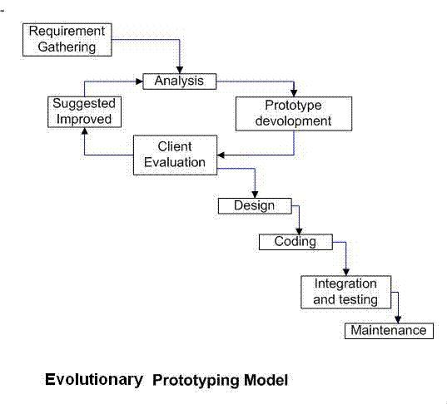
Prototyping Model

Slide 46
When to use Prototyping Model
List of things to consider when using the Prototyping Model:
the requirements are unclear
if requirements are changing quickly.
can be successfully used for developing user interfaces, high technology software-intensive systems, and systems with complex algorithms and interfaces.
a very good choice to demonstrate the technical feasibility of the product.

Slide 47
Prototyping Model - Advantages
errors can be detected in the initial stage of the software development process.
Missing functionality can be identified, which helps to reduce the risk of failure
Customer satisfaction exists because the customer can feel the product at a very early stage.
As customers are involved from the early stage, there will be hardly any chance of software rejection.
Quicker user feedback helps you to achieve better software development solutions.
It is a straightforward model, so it is easy to understand.
No need for specialized experts to build the model
The prototype serves as a basis for deriving a system specification.
The prototype helps to gain a better understanding of the customer's needs.
Prototypes may offer early training for future users of the software system.

Slide 48
Prototyping Model - Disadvantages
There may be too much variation in requirements each time the prototype is evaluated by the customer.
Poor Documentation due to continuously changing customer requirements.
It is very difficult for the developers to accommodate all the changes demanded by the customer.
There is uncertainty in determining the number of iterations that would be required before the prototype is finally accepted by the customer.
After seeing an early prototype, the customers sometimes demand the actual product to be delivered soon.
Developers in a hurry to build prototypes may end up with sub-optimal solutions.
The customer might lose interest in the product if he/she is not satisfied with the initial prototype.

Slide 49

Prototyping Model
Do we need prototyping??
Two “points of interest” for companies to adopt prototyping based methodologies are:
Point 1: They allow us to reduce the cost and time-to-market of a system.
Point 2: For companies building critical systems, prototyping would help them perform formal verification when required. These methodologies provide high level of reliability in the system design and implementation.

Slide 50
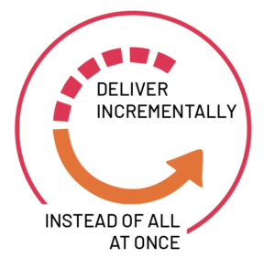
Agile Development
Agile is a set of practices, values, and principles for software product development.
The core ideas in Agile Development:
  Adaptive
  Iterative/incremental
  People-oriented
Adaptive means that the teams and the process should be flexible in the presence of “rapid-fire change”.
Iterative and incremental means that Agile Development produces working products in stages – a growing set of “completed and working software”.
People-oriented means the team organization and processes will support good people, who are the most important ingredient to project success.

Slide 51
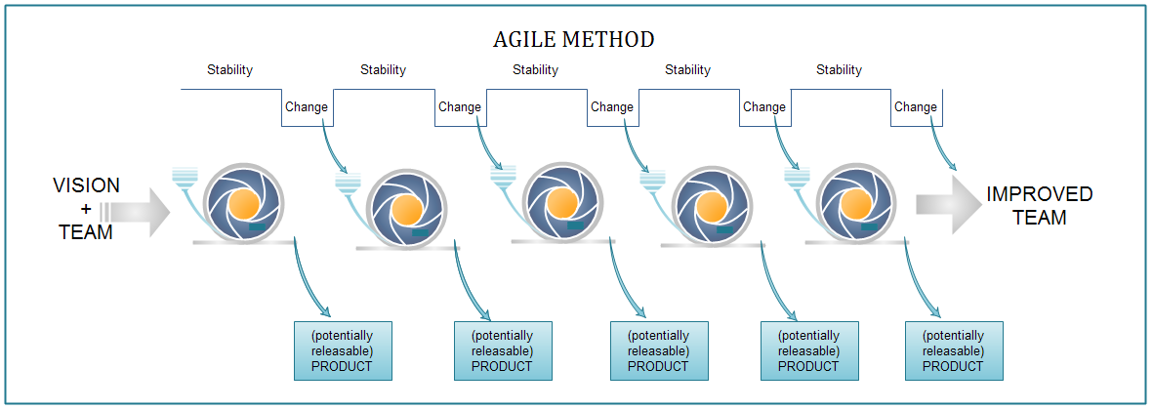
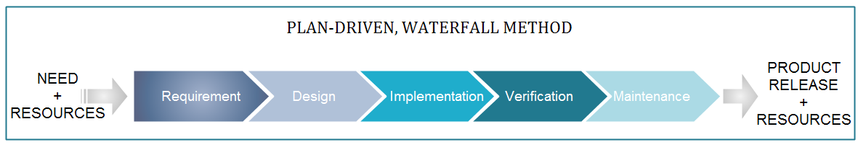
Agile Development
Agile focuses on keeping the process lean and creating minimum viable products (MVPs) that go through a number of iterations before anything is final.

Slide 52
When to use Agile
When new changes are needed to be implemented and you need to get the project delivered in a short amount of time
your project involves iterative, or cyclical, processes in which incremental results will add value for your project .
If you do have some budget flexibility
trying to build something innovative that does not exist
High Product Owner Involvement.
your organization doesn’t have strict processes to follow, and you have the luxury of being able to work flexibly

Slide 53
Agile Development - Advantage
Customer satisfaction by rapid, continuous delivery of useful software.
People and interactions are emphasized rather than process and tools.
Customers, developers and testers constantly interact with each other.
Working software is delivered frequently (weeks rather than months).
Face-to-face conversation is the best form of communication.
Close, daily cooperation between business people and developers.
Continuous attention to technical excellence and good design.
Regular adaptation to changing circumstances.
Even late changes in requirements are welcomed

Slide 54
Agile Development - disadvantage
In case of some software deliverables, especially the large ones, it is difficult to assess the effort required at the beginning of the software development life cycle.
There is lack of emphasis on necessary designing and documentation.
The project can easily get taken off track if the customer representative is not clear what final outcome that they want.
Only senior programmers are capable of taking the kind of decisions required during the development process. Hence it has no place for newbie programmers, unless combined with experienced resources.

Slide 55


Agile Development
Why are SW industries adopting Agile development methods ????
For Success ….Organization success is about delivering value to its clients.
SUCCESS
For Organization
For Clients

Slide 56
Agile Development - Scrum
Scrum is an agile framework that allows us to focus on delivering the highest business value in the shortest time.
It allows us to rapidly and repeatedly inspect actual working software (every two weeks to one month).
The business sets the priorities. Teams self-organize to determine the best way to deliver the highest priority features.
Every two weeks to a month anyone can see real working software and decide to release it as is or continue to enhance it for another sprint.

Slide 57
Agile Development - XP
Extreme Programming (XP), originally described by Kent Beck
is a disciplined approach to delivering high-quality software quickly and continuously.
is intended to improve software quality and responsiveness in the face of changing customer requirements
original XP method is based on four simple values – simplicity, communication, feedback, courage.
Also has twelve supporting practices:
Planning Game Small Releases Customer Acceptance Tests Simple Design Pair Programming Test-Driven Development | Refactoring Continuous Integration Collective Code Ownership Coding Standards Metaphor Sustainable Pace

Slide 58
Agile Development – XP Practices
Planning Game
  Planning for the upcoming iteration and Uses stories provided by the customer
  Technical persons determine schedules, estimates, costs, etc
  A result of collaboration between the customer and the developers
Small Releases
  Small in terms of functionality
  Less functionality means releases happen more frequently
  Support the planning game
Metaphor
  The oral architecture of the system
  Encourages a common set of terms for the system
  A quick and easy way to explain the system
Simple Design
  Do as little as needed, nothing more
  Easier to understand what is going on
  Helps keeps programmers on track
Testing
  Unit testing - promote testing completeness
  Test-first design - gives developers a goal
  All automated - gives a suite of regression

Slide 59
Agile Development – XP Practices
Refactoring
  Refactoring is about removing redundancy, eliminating unnecessary functions, increasing code coherency
  Improves the quality of the system in some way and Increases developer knowledge of the system
Pair Programming
  Two Developers, One monitor, One Keyboard
  One “drives(Driver)” and the other thinks(Navigator)
  Switch roles as needed
  Two people are more likely to answer the following questions:
    Is this whole approach going to work?
    What are some test cases that may not work yet?
    Is there a way to simplify this?

Slide 60
Agile Development – XP Practices
Pair Programming
    Benefits:
      Two sets of eyes catch errors early, resulting in fewer bugs and higher quality code.
      Enhances Collaboration and Communication
      Knowledge sharing happens naturally as pairs switch roles, exposing each developer to different parts of the codebase.
      Continuous feedback between the Driver and the Navigator often leads to better design choices
    Challenges:
      For pair programming to be effective, both developers need to communicate clearly and respectfully.
      Especially for less experienced developers, it can be daunting to code in front of someone else, potentially leading to anxiety or hesitation. Chance of Imbalance team
      It requires two developers to work on a single task, which can seem like a waste of resources compared to working individually, especially if not used effectively.
    Best Practices:
      Switch Roles Regularly
      Communicate Openly
      Set Clear Goals
      Choose Compatible Pairs
      Take Breaks

Slide 61
Agile Development – XP Practices
Collective Ownership
  The idea that all developers own all of the code
  Enables refactoring
  Helps mitigate the loss of a team member leaving
  Promotes developers to take responsibility for the system as a whole rather than parts of the system
Continuous Integration
  New features and changes are worked into the system immediately
  practice where members of a team integrate their work frequently, usually each person integrates at least daily
Benefits | Challenges | Best Practices
Early Bug Detection Improved Code Quality Faster Development Cycles Reduced Integration Problems Better Collaboration Supports Continuous Delivery (CD) | Initial Setup Complexity Maintenance of Test Suites Cultural Shift Infrastructure Costs | Commit Frequently Maintain a Fast, Reliable Build Write Meaningful Tests Keep the CI Pipeline Visible Address Failures Immediately

Slide 62
Agile Development – XP Practices
40-Hour Workweek
  The work week should be limited to 40 hours
  Regular overtime is a symptom of a problem and not a long term solution
  Most developers lose effectiveness past 40-Hours
  Value is placed on the developers well-being
  Management is forced to find real solutions
On-site Customer
  Gives quick and continuous feedback to the development team
  Can give quick and knowledgeable answers to real development questions
  Makes sure that what is developed is what is needed
  Functionality is prioritized correctly
Coding Standards
  All code should look the same
  It should not possible to determine who coded what based on the code itself
  Reduces the amount of time developers spend reformatting other peoples’ code

Slide 63
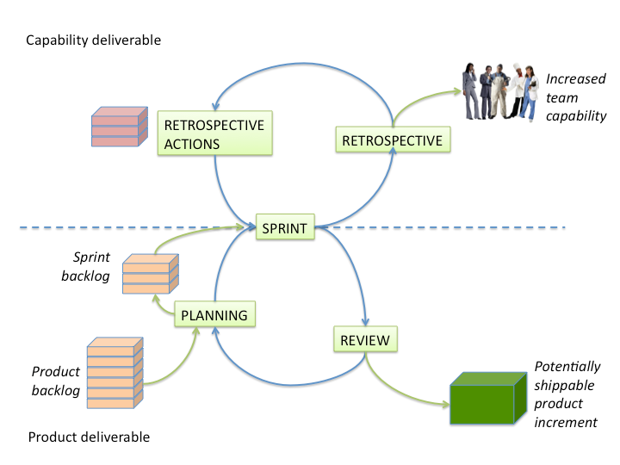
Scrum
A framework within which people can address complex adaptive problems, while productively and creatively delivering products of the highest possible value.
Scrum is:
  Lightweight
  Simple to understand
  Difficult to master

Slide 64
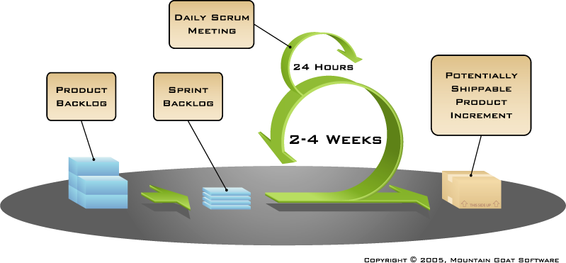
More on Scrum
Events
Sprint planning
Sprint review
Sprint retrospective
Daily scrum meeting
Scrum Framework
Roles
Product owner
ScrumMaster
Team
Artifacts
Product backlog
Sprint backlog
Definition of Done
Burndown charts

Slide 65
Scrum - Roles
Product owner
  Clearly expressing Product Backlog items
  Ordering the items in the Product Backlog to best achieve goals and missions
  Optimizing the value of the work the Development Team performs
  Ensuring that the Product Backlog is visible, transparent, and clear to all, and shows what the Scrum Team will work on next
  Ensuring the Development Team understands items in the Product Backlog to the level needed.
Team
  The Development Team consists of professionals who do the work of delivering a potentially releasable Increment of “Done” product at the end of each Sprint.
  Development Teams have the following characteristics:
    They are self-organizing. No one (not even the Scrum Master) force the Development Team how to turn Product Backlog into Increments of potentially releasable functionality;
    Scrum recognizes no titles for Development Team members, regardless of the work being performed by the person;
    Scrum recognizes no sub-teams in the Development Team, regardless of domains that need to be addressed like testing, architecture, operations, or business analysis; and,
    Individual Development Team members may have specialized skills and areas of focus, but accountability belongs to the Development Team as a whole.

Slide 66
Scrum - Roles
ScrumMaster
  Scrum Master Service to the Product Owner
    Ensuring that goals, scope, and product domain are understood by everyone on the Scrum
    Finding techniques for effective Product Backlog management
    Helping the Scrum Team understand the need for clear and concise Product Backlog items;
    Understanding and practicing agility; and,
    Facilitating Scrum events as requested or needed.
  Scrum Master Service to the Development Team
    Coaching the Development Team in self-organization and cross-functionality;
    Helping the Development Team to create high-value products;
    Removing impediments to the Development Team’s progress;
    Facilitating Scrum events as requested or needed; and,
    Coaching the Development Team in organizational environments in which Scrum is not yet fully adopted and understood.
  Scrum Master Service to the Organization
    Leading and coaching the organization in its Scrum adoption;
    Planning Scrum implementations within the organization;
    Helping employees and stakeholders understand and enact Scrum and empirical product development;

Slide 67




Scrum - Events
Sprint planning (typically 2 hrs for each week)
  Sprint Planning answers the following:
    What can be delivered in the Increment resulting from the upcoming Sprint?
    How will the work needed to deliver the Increment be achieved?
Sprint Planning Meeting
Sprint
goal
Team capacity
Sprint prioritization
Product backlog
Analyze and evaluate product backlog
Select sprint goal
Business conditions
Sprint planning
Decide how to achieve sprint goal (design)
Create sprint backlog (tasks) from product backlog items (user stories / features)
Estimate sprint backlog in hours
Current product
Sprint
backlog
Technology

Slide 68
Scrum - Events
Sprint review (2 to 4 hrs)
  Attendees include the Scrum Team and key stakeholders invited by the Product Owner.
  The Product Owner explains what Product Backlog items have been “Done” and what has not been “Done”.
  The Development Team discusses what went well during the Sprint, what problems it ran into, and how those problems were solved.
  The entire group collaborates on what to do next, so that the Sprint Review provides valuable input to subsequent Sprint Planning.
  Review of how the marketplace or potential use of the product might have changed what is the most valuable thing to do next.
  Review of the timeline, budget, potential capabilities, and marketplace for the next anticipated releases of functionality or capability of the product.

Slide 69

Scrum - Events
Sprint retrospective (1-2 hrs)
  The purpose of the Sprint Retrospective is to:
    Inspect how the last Sprint went with regards to people, relationships, process, and tools;
    Identify and order the major items that went well and potential improvements; and,
    Create a plan for implementing improvements to the way the Scrum Team does its work..
  Whole team gathers and discusses what they’d like to:
Start doing
Stop doing
This is just one of many ways to do a sprint retrospective.
Continue doing

Slide 70

Scrum - Events
Daily Scrum (15 mins)
  Parameters
    Daily
    15-minutes
    Stand-up
  Not for problem solving
  Whole world is invited
  Only team members, ScrumMaster, product owner, can talk
  Helps avoid other unnecessary meetings and everyone answer three Questions:
1
What did you do yesterday?
2
What will you do today?
3
Is anything in your way?

Slide 71
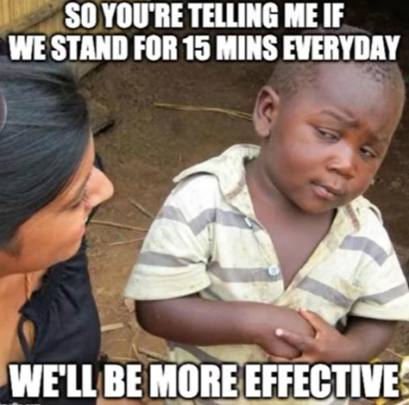

Slide 72
Scrum - Artifacts
Product backlog
  The requirements
  A list of all desired work on the project
  Ideally expressed such that each item has value to the users or customers of the product
  Prioritized by the product owner
  Reprioritized at the start of each sprint

Slide 73
Scrum - Artifacts
Sprint backlog
  is the set of Product Backlog items selected for the Sprint
  is a forecast by the Development Team about what functionality will be in the next Increment
  Sprint Backlog will be changed for the following reasons:
  Over time, the development team has a better understanding of the requirements and may find that new tasks need to be added to the Sprint Backlog.
  Bugs of features are added as new tasks, which are all unfinished tasks committed previously of the Sprint.

Slide 74
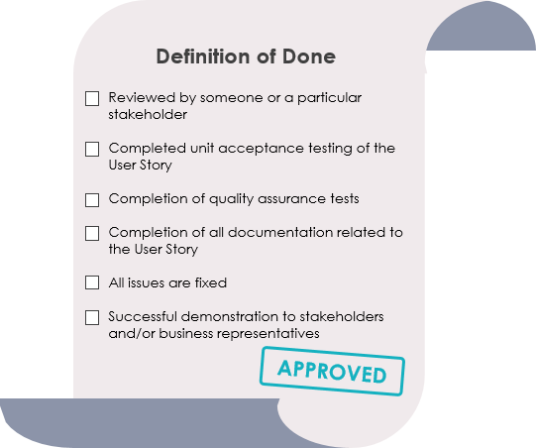
Scrum - Artifacts
Definition of Done (DoD)
  Every Product Backlog item has acceptance criteria that define measurably what must be met when the item is declared to be done.
  Definition of Done is a shared understanding of the Scrum Team on the meaning of work to be complete.
  It typically contains quality criteria, constraints and overall non-functional requirements.

Slide 75
Scrum - Artifacts
Burndown chart
  are graphs that give an overview of progress over time while completing a project.
  this chart starts with the total number of points the team has taken on for the sprint, and tracks on a day-to-day basis how many of those points have been completed and are ready for the sprint demo.
  As tasks are completed, the graph “burns down” to zero.
  is usually maintained by the scrum master, and may be updated on a daily basis, perhaps after the daily scrum.
  A typical burndown chart starts with a straight diagonal line from the top left to the bottom right, showing an “ideal” burndown rate for the sprint.
  Team Velocity is the average number of story points completed per sprint
  Used to measure a team’s delivery capacity
Velocity = Total Story Points completed in a sprint
Average velocity = Mean of last 3–5 sprints

Slide 76
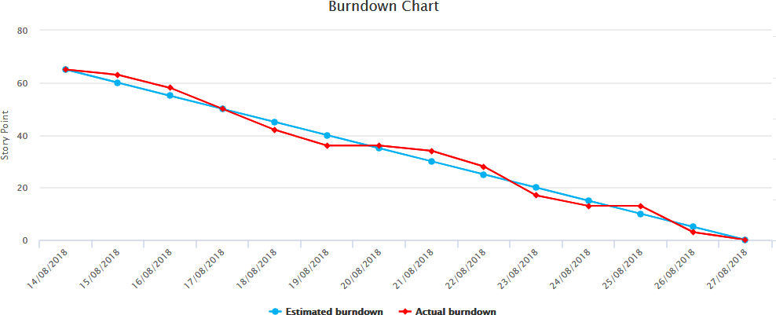
Scrum - Artifacts

Slide 77
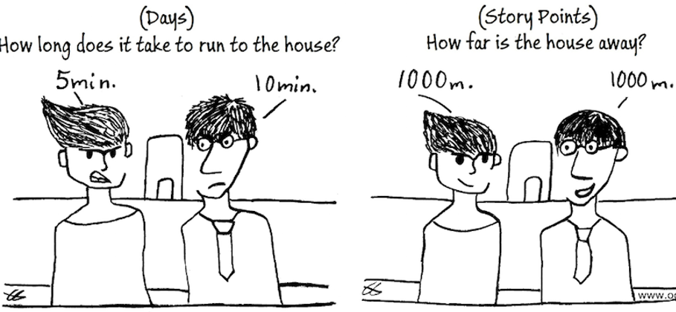
Story points ????
Story Points are a relative measure of effort, not time
Used to estimate:
  Complexity
  Amount of work
  Uncertainty / risk
Story Points compare work items relative to each other, not in hours or days.
Why Story points? Why not map story points with time? What’s the issue?

Slide 78

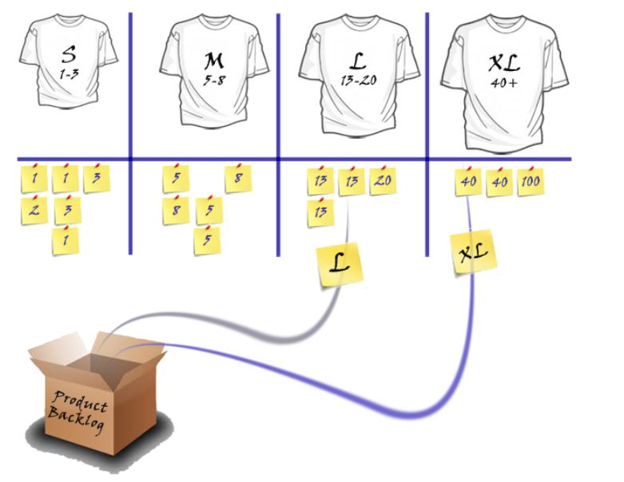
How are Story Points Expressed
The story points can be expressed in two different ways
As Numerical Range in terms of Fibonacci Sequence
As T shirt Size Range in terms of X-S, i.e. Extra Large

Slide 79
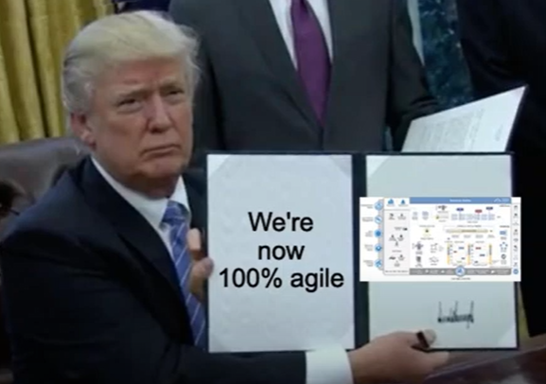

Slide 80
Choosing the right Software development life cycle model

Slide 81
Selecting right SDLC
Stakeholders Need
business domain, stakeholders concerns and requirements, business priorities need to be considered
02
Learn SDLC
01
Should have proper knowledge of SDLC
Need to understand those.
Decide
give each criterion a defined weight and score for each option. you should document this decision and share it with the related stakeholders.
04
Define the Criteria
03
Is the SDLC suitable for the size of team and their skills?
Is the SDLC suitable for the selected technology we use for implementing the solution?
Is the SDLC suitable for client and stakeholders concerns and priorities?
Is the SDLC suitable for the geographical situation (distributed team)?
Is the SDLC suitable for the size and complexity of software?
Is the SDLC suitable for the type of projects we do?
Is the SDLC suitable for our software engineering capability?
Optimize
You can always optimize the SDLC during the project execution
You can even make your own SDLC model which optimum for your organization or the type of projects you are involved in.
05

Slide 82
Benefits of Selecting right SDLC
By Slecting the right lifecycle model, we can improve and/or tradeoff:
  Development speed (time to market)
  Product quality
  Project visibility
  Administrative overhead
  Risk exposure
  Customer relations, etc, etc.

Slide 83
Next Class
Requirements Analysis and UI Design

